Slide 1


The Mosaic
Hinton St Mary
September 2026
Well the time is here for me to take over, and what an honor it is, I promise to do my
Best to keep this going as long as I can.
Frist thing I must write about is a massive thank you to Jo and Nigel I not only have two shoes to fill but four I hope I can do it justice.
A bit about myself for the only time, as this is yours not mine.
I am the partner of Mark everyone knows him as (Steggs) he is now going to be the honorable chief stapler.
I moved to Dorset 19 years ago after buying a tearoom in Blandford, we moved to Sturminster in a flat above Holbrooks. Well say the least the tearoom didn’t survive after about a year.
I met Mark a year later and as they say the rest is history. I have three grown-up children and six grandchildren all which are my shining stars.
Now the rest is up to you all, this is your newsletter let me know what you would like to see, if you want to celebrate a birthday, or an anniversary, even your dog or cat.
Any recipes you would like to share.

Slide 2
Dear Residents,
At our recent Parish Council meeting in August a number of items were discussed including:
Wessex Water New Pumping Station
A number of residents in Veals Lane and Castlemans lane have experienced unusual odours. Wessex Water are investigating and have thoroughly cleaned the pumping station and started chemical dosing to help address this issue. If I can support any household in HSM please contact me (details below)
20mph speed limit
We applied for consideration of a 20mph zone (most of village excluding B3092)after overwhelming support early in 2025 and we await next steps from Dorset Council.
Excessive Speeding B3092
At our next Council meeting scheduled for 7pm 10th November in the Village Hall excessive speeding by a minority of motorists will be on our agenda. We welcome any villager to our meeting.
Road Repairs
Veals lane (where it joins Castlemans lane) has been made flat so cars are no longer subject to grounding and Ridgeway lane will be closed from early Oct to early Nov whilst Dorset Council undertake repairs.
Thank you Dorset Council.
Marnhull Road leaning Telegraph Pole & Unstable Bank
The PC has reported concerns re the leaning Telegraph pole, unstable pavement and concerns regarding the unstable bank outside Nicholsons Cottages.
Whilst Dorset Council have undertaken some pavement repairs we continue to ask them to address the leaning Telegraph pole and unstable bank.
Celia Wright
On behalf of PC
07584 151600
celia.wright@icloud.com

Slide 3
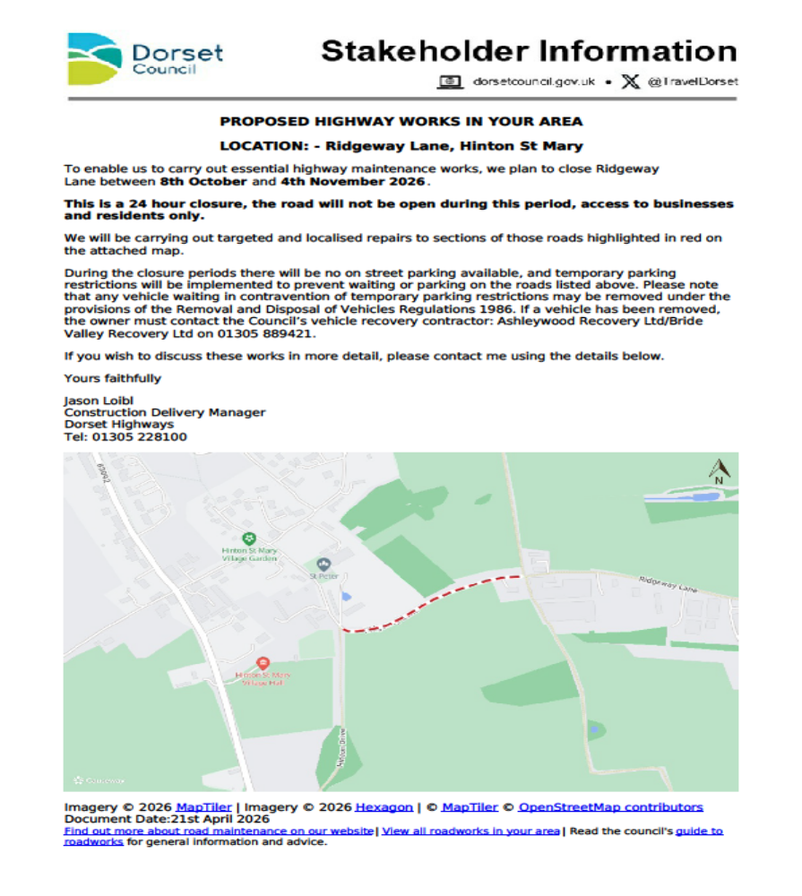

Slide 4

What's On at Hinton Workspace This September
September is set to be buzzing at Hinton Workspace. As the summer holidays wind down and everyone gets back to business, there really is something for everyone this month. Whether you're looking to grow your business contacts, invest in a bit of personal development, or simply meet like-minded people from across North Dorset.
For those wanting to build connections, the month kicks off on Thursday 3rd September with The Hinton Hustle, North Dorset's favourite monthly networking event for business owners, entrepreneurs, freelancers and professionals.
On Wednesday 9th September, the Property Networking Breakfast returns, bringing together professionals from across the property sector for a focused, high-quality morning of connection. And on Friday 18th September, Hinton Workspace teams up with Dorset Chamber for a 'Walk in Nature around Hinton St Mary. Networking at a gentler pace, with fresh air and conversation in equal measure. A unique guided walk through the historic Hinton St Mary Estate with Alice Fox-Pitt, Founder of Hinton Workspace.
Steeped in over 1,600 years of history, Hinton St Mary is a place where Roman Britain, medieval Dorset and modern rural life sit side by side. From hidden historic treasures to internationally recognised sporting success, this is a rare opportunity to discover one of Dorset's most remarkable estates.
On the personal development side, Wednesday 16th September brings What Flavour Is Your ADHD?, a workshop run in partnership with Chaos Orchestra. It goes beyond the stereotypes to help you understand your ADHD and work with it, not against it. Whether you're diagnosed, think you might have ADHD, support someone who does, or are simply curious, you'll leave with practical insights and techniques you can use straight away.
Then on Tuesday 29th September (12pm–2.30pm), Christophe Stourton and renowned speaking coach Jackie Goddard host Nail Your Networking Introduction — a practical two-hour workshop to help you find the real story behind your business and turn it into a simple, memorable four-line introduction.
And there's something brand new too: Thursday 24th September sees the launch of the Hinton Wellness Collective, a new community bringing together wellbeing professionals from across Dorset to connect, collaborate and grow.
Find out more and join any of these brilliant
Events on our website: hintonworkspack.co.uk

Slide 5
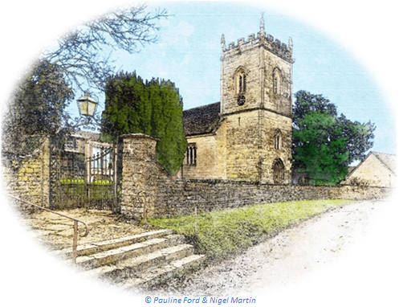

St Peter’s Church
September 2026 Services
All services at 9:30am unless otherwise noted
Date & Time
Service
Sunday 6 September
Holy Communion (BCP)
Sunday 13 September
Morning Prayer (BCP)
Sunday 20 September
Morning Prayer
Sunday 27 September
Holy Communion (CW)
Church is open daily for sanctuary and prayer
Village Harvest Festival
Our Harvest Festival will take place on Sunday, 18 October. 10:30 Harvest Festival Service in St Peter’s with a bring & share lunch in the Tithe Barn from midday. Everyone is welcome to either or both village events.
All queries about Church-related support and services should be directed to the Vicar or Churchwardens.
Vicar: The Reverend Mary Gubbins 01258 721 704 | 07440 680 387 | The Vicarage, Sturminster Newton revd.mary.gubbins@gmail.com
Churchwardens
Robin Gibbs 01258 471 493 robin@aviaconsult.uk | Kevin Peto-Bostick 01258 475 469 kevin.peto.bostick@gmail.com

Slide 6

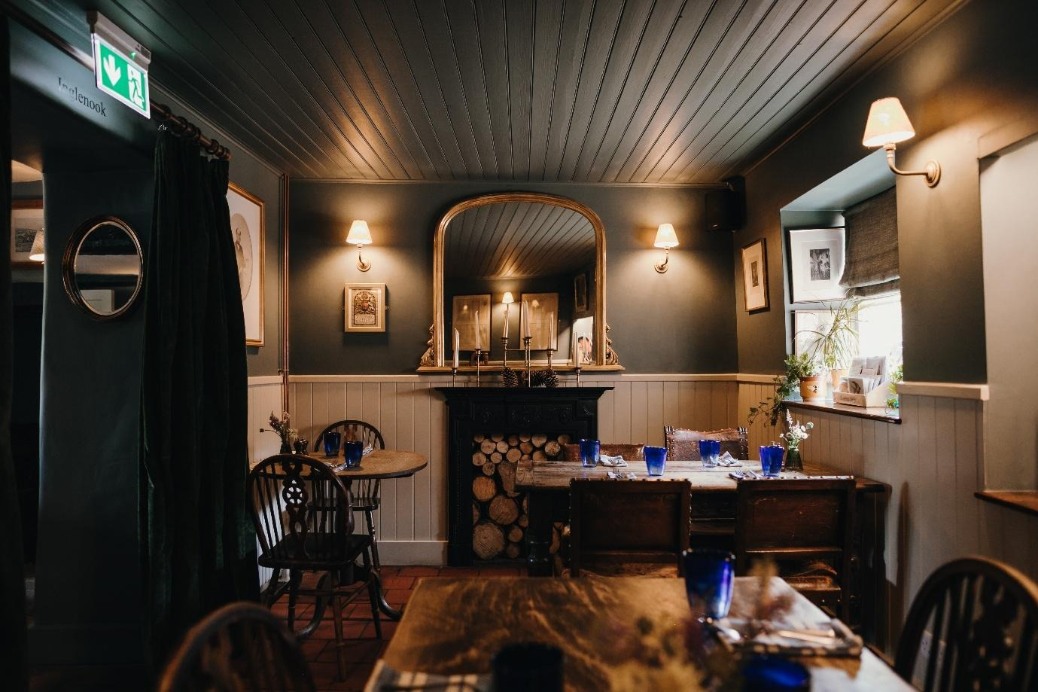

Hello Hinton
As summer comes to an end we have a great live music event planned on Sunday
the 30 th of August. Malea is joining us again for some beautiful jazz and soul. She
will start shortly after 6pm. We are hoping for some late summer sunshine but we
can always move inside if it does rain.
As we move into Autumn we have more events planned. On Sunday the 25 th of
October we will have our annual Halloween party, more to be announced soon. On
Sunday the 8 th of November The Belle St Duo return for their fabulous show of
modern pop sung in a vintage style.
As usual Mark & Jane’s quiz night is on Sunday 6 th of September. 7pm start, teams
up to 6, only £2 per person entry.
This quarter we are raising money for Dorset & Somerset Air Ambulance through
sales of our Mosaic lager. Thank you for all your continuous support, and hope to
see you all in the Autumn.
Best Wishes
Mel, Andy and all from The White Horse

Slide 7

LEMON POSSET
Ingredients:
3 un-waxed lemons
600g double cream
150g caster sugar
Method
1. Finely grate the lemons and retain zest.
2. Squeeze the lemons and you require about 140ml juice.
3. Retain zest and juice - do not add to cream.
4. Bring the double cream and caster sugar to a boil in a small pan stirring to dissolve the sugar and simmer for 1-2 minutes.
5. Remove cream and sugar mixture from heat and whisk in zest and 140ml lemon juice.
6. Divide between 8 glasses.
7. Chill in fridge for a minimum of 3 hours or overnight.

Slide 8
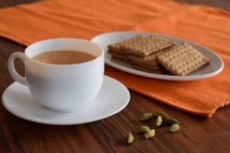
THE MONTHLY VILLAGE COFFEE MORNING
TUESDAY 1ST SEPTEMBER
10.30 – 12.00
The cost is £1.50– for as much coffee or tea as you can drink
and as many biscuits as you can eat.
BLANDFORD HOSPITAL SHOP WAREHOUSE. Is open to receive donations at its warehouse in The Building Yard HSM on Saturday 5th September 10 - 12 midday Old Poisedale Building, Hinton St. Mary
IF YOU LIVE IN HINTON ST MARY AND DO NOT RECEIVE A COPY OF THE MOSAIC EVERY MONTH – PLEASE LET JANE KNOW ON 07513 632550 OR EMAIL janefilbey1964@gmail.com
Please let me have any articles, notices, celebrations, information, items for sale, trusted traders etc you would like to have included in next month’s Mosaic. Deadline 24th of the Month. Thank you, Jane. Janefilby1964@gmail.com
VILLAGE HALL to enquire about or book please contact Jane Filbey on 07513 632550 or janefilbey1964@gmail.com
Keep abreast of all things ‘HSM’ on the village facebook page: Hinton St Mary Village Group and the Hinton St Mary Website:
http://www.hintonstmary.com where all previous copies of The Mosaic are also available.
Thank you to our Advertisers and our sponsors:
Mr & Mrs Pitt Rivers, Hinton St Mary Parish Council, St Peter’s Church, HSM Village Hall Committee.
CONTACT THE ESTATE:
If you are out and about on the estate and need to contact us for any reason whatsoever, please call
07511 209705 or email us on info@hintonstmaryestate.com and we will do our best to respond as quickly and possible.

Slide 9

Trusted Traders
These are tradesman/workers who have been personally recommended by villagers. Please let us have details of anybody who has done a great job for you. Thank you.
COMPUTER HELP | TIM WEST | 01258 817537 sturcomputers@hotmail.co.uk
CURTAINS, BLINDS, TRACKS, FABRICS & FITTING (Marnull) | THE CURTAIN MAN (Anna & Tony) | 01258 821117 thecurtainmanshop@gmail.com
CARPENTRY/JOINERY | NIGEL BASTABLE | 01258 860459 www.nigelbastable.co.uk
CARPENTRY (& WOODEN FLOORS) | GARY CORCORAN | 07920557651 gccarpentry@hotmail.co.uk
APPLIANCE REPAIRS | ANDY BLANDFORD | 07484 861797 andyblandford1@gmail.com
PEST CONTROL | MARK GOULD (Rats, Wasps, Moles & Fleas) | 07999 957694 mark_gould2@btconnect.com
BUILDERS | ANDREW TRIM | 07939 541128
FENCING & REPAIRS | DAVID WHITEHAND | 07549 151 799
BOILER MAINTENANCE | BOB JONES & SON | 01963 362 502
PRIVATE CARER | TINA BROWN | 0777 5430457
BUILDING & RENOVATION | MARK GORDGE | 07941 443 306
ROOFING | BEN GIBBS ROOFING | 07912 655095 Bengibbs.roof@gmail.com
SCAFFOLDING | EDW SCAFFOLDING | 07474 552259 elwin1965@icloud.com
HEDGE/TREE CUTTING | HAMBLEDONS 0783347833 | 01258 721552 info@hambeldons.co
PLASTERER | ROBBY PROCTOR | 07872 634677 robbyproctor29@gmail.com
CHIMNEY SWEEP | CHRIS PERRINS 07824 698109 | 01258 837499 cfperrins@gmail.com
PLUMBER | GARY WATKINS | 07887 605112 sales@tradetanks.com

Slide 10


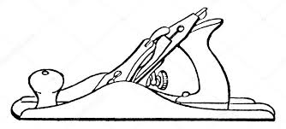

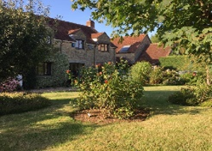
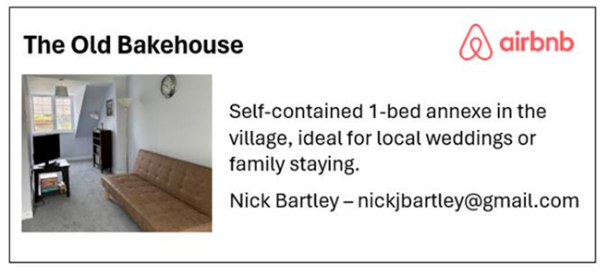
Martin Bennett – Local Mechanic
(based in Hinton St Mary)
I repair and service modern and everyday cars as well as specialising in repairing and restoring classic cars.
I have diagnostics equipment available.
Phone 07746817072
Email martin@mbclassiccars.co.uk
NIGEL BASTABLE LTD
CARPENTRY & JOINERY
The Building Yard – Hinton St Mary
Doors, Windows, Wardrobes, Stairs, Kitchens, Cupboards, Bookcases Etc.
Renovations and Repairs
01258 860459
nigelbastable@btinternet.com www.nigelbastable.co.uk
BABYSITTER & DOG SITTER/WALKER
I am Alice Townsend
I live in Hinton St Mary and I am offering babysitting or dog sitting/ walking in our village.
You can contact me via my phone 01258 474603
Ot my email ar.townsend@outlook.com
Rose’s Yard
Hinton St Mary
Air B and B
Self-Contained first floor annex
in the centre of the village
sleeping 4
Contact Jo
jo.martin99@btinternet.com
07860 612412
Or Book Via Air B & B

