Slide 1
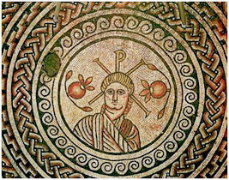
The Mosaic
Hinton St Mary
October 2026
EXTRAORDINARY MEETING
Proposed Ward Changes Dorset
Dear HSM residents,
The Parish Council has been notified that it is proposed that Electoral wards are reviewed and it has been proposed that HSM ward is moved from Stur to Marnhull.
The PC is holding an extraordinary meeting on Wednesday 14th In the Village Hall at 7pm to discuss the proposed changes and we invite all villagers to come along and give their views.
If you cannot attend our meeting in person we would encourage all residents to make their thoughts known to any PC member.
Our councillors are:
Ben Cooper
Mark Steggles
Robbie Bartlett
Jo Curtis
Celia Wright (celia.wright@icloud.com)

Slide 2


SNADS PANTOMIME AUDITIONS
SUNDAY 4 OCTOBER
11AM
Goldilocks &
the Three Bears
Come along and be part of the show
— on stage or behind the scenes —
WE NEED
Set building
Chaperones
Front of house
Band pianist
Costume department
Hair & makeup
Interested? Get in touch:
snads.social@gmail.com
Director Paula
pjskinner67@aol.com
SNADS are pound to bring once again
A Vicar of Dibley Christmas the second coming
Come and watch this hilarious play, with the one liners and much more
On at the exchange on the 29th,30th and 31st October
Tickets are on sale now

Slide 3

0

Slide 4
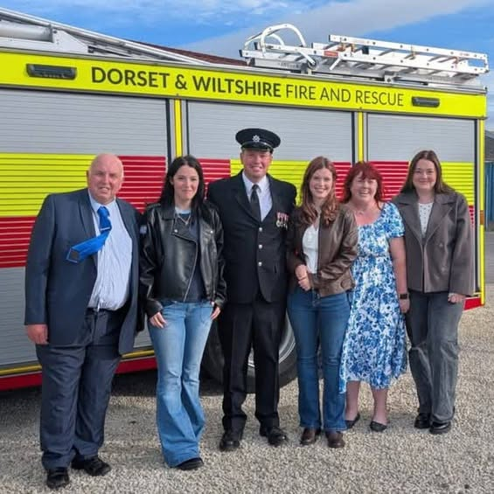
July and August have been busy months for Dorset & Wiltshire Fire and Rescue Service.
The Firefighters at Sturminster Newton have responded to numerous calls during this period, we have spent 100's of hours dealing with a wide range of incidents, such as the major incidents, numerous field/crop fires, heath fires, property fires, road traffic collisions and standby’s at several other stations just to name a few.
On top of these call outs we still have to do our regular equipment checks, appliance cleaning and maintenance, training days, drill nights or any other task to keep us ready at a moments notice.
We are very lucky to have the support of all the local businesses that release their staff to attend these incidents and more importantly our families and loved ones who have supported and sacrificed many things so we can carry out our jobs as on call firefighters, we appreciate them all.
It is also very important to recognise our Firefighters for their achievements. FF Steve Dennett attended the Fire Service awards ceremony on Saturday 12th September to receive his 20 year long service and good conduct medal. 20 years is an exceptional milestone for an on call firefighter. Congratulations and Well done Steve.
We are still actively recruiting for new firefighters to add to our team. If you are interested in becoming an on call firefighter please come and see us at our drill night on a Monday evening from 18:30 - 21:00 or visit our website www.dwfire.org.uk/on-call-firefighters.
Stuart Frear

Slide 5


Hello Hinton
A big thank you to all of you for coming to support Malea & Pete. We are so
fortunate to have such a great pool of talent right here in Hinton.
Here is a little reminder of what is to come in Autumn:
Sunday 4 th October Mark & Jane’ s Quiz evening starting at 7pm.
Sunday 25 th of October our Halloween party starting at 6:30pm ( as we know some
may need to get up on Monday morning). Thank you to Seve Wills for lending his DJ
skills. As usual there will be a prize for best costume and best pumpkin carving (kids
&amp; adults)
Sunday 1 st November Mark & Jane’s Quiz Night starting at 7pm.
Sunday 8 th November Live performance from The Belle St Duo time to be confirmed
next month.
This month we say goodbye to our university students in the village and at the pub –
we wish them all the best of luck and look forward to seeing them all for Christmas.

Slide 6

Christmas Eve Thursday 24 th December Lunch & dinner open all day for drinks.
Limited tables left please call 01258915001 to book
Christmas Day drinks 12pm -2pm. We would love to see you all
Boxing Day closed
Sunday 27 th December open until 5pm. We are serving an a-la- carte menu but not
roast dinners.
Monday 28 th December, Tuesday 29 th December & Wednesday 30 th December open
for lunch and Dinner.
Thursday 31 st of December open for lunch & dinner. Please call to book your tables
for New Year’s Eve.
Friday 1 st January until Tuesday 5 th January Closed
Wednesday 6 th January Open as usual
Christmas Party Menu
Pheasant, chestnut & cranberry terrine, toast
Houghton springs trout Gravlax, fennel, watercress, mustard dressing
Heritage beetroot, English goat’s curd & walnut salad
Celeriac soup, chestnuts, bacon
smoked haddock beignets, aioli
Hinton st Mary venison ragu, gnocchi, parmesan
Traditional Roast Turkey, all the trimmings (minimum 6 people)
Slow roast belly of pork, carrots, mash potato, winter cabbage, red wine jus
Fillet of Cornish fish, crushed potatoes, seasonal greens, warm tartare sauce
Roasted butternut squash risotto, Pecorino
Dorset blue Vinney, crackers, tawny port
Chocolate cremeaux, oranges, honeycomb
Sticky Toffee Pudding, toffee sauce, vanilla ice cream
Christmas affogato, espresso, Pedro Ximenez sherry
honey pannacotta, mulled wine, poached pear, spiced shortbread
2 courses - £32.5 3 courses - £39.5
menu available for pre-order 1 week before party
from Wednesday 2nd December - Tuesday 22nd December (not available on
Sundays)
please advise us of any dietary requirements

Slide 7

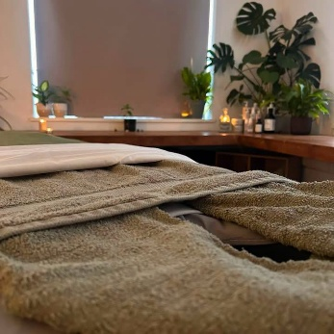

Thank You
I had a dream 15 years ago of one day having my own beauty studio. After moving to Dorset, I left that dream behind in London where I used to work as a mobile therapist alongside my job with NatWest, so that I could start a life in Dorset and have a family.
Life threw my family a curveball with Andy’s brain tumour diagnosis. During his illness I knew I needed a career that would work around the children, so I spent my rest bite days retraining in the beauty industry. I spoke to Alice about my plans and she supported me with helping my dream become a reality and I now have a beauty studio in the heart of Hinton St Mary. Without Alice Fox-Pitt and Michelle Maidment I am not sure my dream would have taken off, their belief in me and continued support has helped make it a reality.
I also want to say a massive thank you to the villagers that have supported me by booking in with either me or Toni or telling people about us. I am grateful that you have trusted and supported us.
We really want to be an asset to the village so if there is a treatment or service that we don’t offer but you would like please let us know as we are constantly training and bringing in new services and we are open to suggestions. If you are someone in the village who would like a treatment but are unable to get to us let us know as some services, we can bring to your home.
Toni and I are both fully insured members of The Guild of Beauty Therapists, we offer Facials, Massage, Indian head massage, Spa Treatments, Brow and Lash services and Waxing.
We open by appointment
Monday – Friday 10:00am – 7:00pm and Saturdays 9:00am – 12:30pm
From the bottom of my heart Thank you
Gemma Hampton MGBT
07752761731
Gemmahamptonbeauty@outlook.com

Slide 8
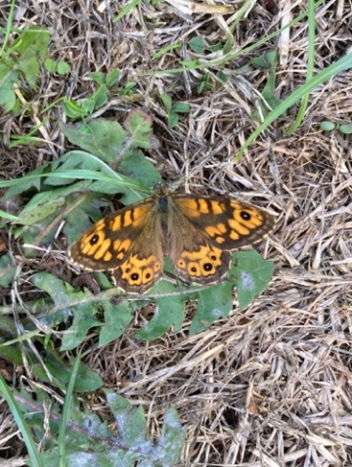
Millennium Garden Volunteers
After a summer with very little to report, apart from a lot of
hard work keeping the planting alive and everything in order,
we suddenly find ourselves with a garden which has sprung
back to life. The wildflower areas have attracted insects
throughout the dry months and as well as our usual visiting
bees, butterflies and dragonflies, we have had our share of
our less common butterflies such as wall brown and clouded
yellow as well as hummingbird hawk moth and Jersey tiger
moth. We have also found toads in residence and there
have been occasional sparrowhawk appearances.
Now, with a little rain we are also seeing some colour returning as autumn plants are showing through. We have a good show of sedum, tiny cyclamen and asters while
some of the summer flowers are still showing up.
showing through. We have a good show of sedum, tiny cyclamen and asters while
some of the summer flowers are still showing up
While we still welcome visitors who come to enjoy the peace of the garden and kids,
enjoying a chance to explore and play, we have had our patience tested this summer
by less welcome visitors leaving glasses and rubbish behind them. We decided on a
very simple solution and moved the picnic table out of view from the road, which
appears to have worked. It is still in the garden and available for use, just not
confusing people into thinking we are an annex of the White Horse. We just ask that
those using the garden take responsibility for their children, dogs and rubbish.
Our orchard area has been affected by the weather and probably the heavy crop last
year. We managed a little light pruning which should help the health of the trees in
subsequent years. As a result, we don’t expect to have the same problems with
fallen apples this year, although the leaves will be a different matter!
We are always glad to have any help on offer. You will find us working in the garden
most Monday afternoons when weather permits. For more information contact
gmjames28@icloud.com.

Slide 9
RECIPE OF THE MONTH
Creamy Boursin chicken orzo bake
SERVES 4 • PREP 15 MIN • BAKE 35 MIN
INGREDIENTS
METHOD
FOR THE BAKE
— 500g chicken breast, cut into bite-sized pieces
— 250g orzo
— 1 small onion, finely chopped
— 2 garlic cloves, crushed
— 600ml hot chicken stock
— 1 tsp dried oregano
TO FINISH
— 150g Boursin Garlic & Herbs
— 150g cherry tomatoes, halved
— 100g baby spinach
— Black pepper
1 Heat the oven to 200°C / 180°C fan / Gas 6. Tip the orzo, onion, garlic, stock and oregano into a lightly greased baking dish; stir well.
2 Season the chicken with black pepper and arrange it over the orzo. Nestle in the tomatoes, cover tightly with foil and bake for 20 minutes.
3 Stir, then dot the Boursin over the dish. Bake uncovered for 12–15 minutes, until the chicken is cooked through and the orzo is tender.
4 Fold through the spinach and rest for 5 minutes. Loosen with a splash of boiling water if needed, then spoon into warm bowls.
To serve Add a crisp green salad and a squeeze of lemon for freshness.

Slide 10
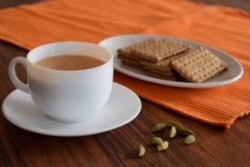
THE MONTHLY VILLAGE COFFEE MORNING
TUESDAY 6ST OCTOBER
10.30 – 12.00
The cost is £1.50– for as much coffee or tea as you can drink
and as many biscuits as you can eat.
BLANDFORD HOSPITAL SHOP WAREHOUSE. Is open to receive donations at its warehouse in The Building Yard HSM on Saturday 10th October 10 - 12 midday Old Poisedale Building, Hinton St. Mary
IF YOU LIVE IN HINTON ST MARY AND DO NOT RECEIVE A COPY OF THE MOSAIC EVERY MONTH – PLEASE LET JANE KNOW ON 07513 632550 OR EMAIL janefilbey1964@gmail.com
Please let me have any articles, notices, celebrations, information, items for sale, trusted traders etc you would like to have included in next month’s Mosaic. Deadline 24th of the Month. Thank you, Jane. Janefilby1964@gmail.com
VILLAGE HALL to enquire about or book please contact Jane Filbey on 07513 632550 or janefilbey1964@gmail.com
Keep abreast of all things ‘HSM’ on the village facebook page: Hinton St Mary Village Group and the Hinton St Mary Website:
http://www.hintonstmary.com where all previous copies of The Mosaic are also available.
Thank you to our Advertisers and our sponsors:
Mr & Mrs Pitt Rivers, Hinton St Mary Parish Council, St Peter’s Church, HSM Village Hall Committee.
CONTACT THE ESTATE:
If you are out and about on the estate and need to contact us for any reason whatsoever, please call
07511 209705 or email us on info@hintonstmaryestate.com and we will do our best to respond as quickly and possible.

Slide 11

Trusted Traders
These are tradesman/workers who have been personally recommended by villagers. Please let us have details of anybody who has done a great job for you. Thank you.
COMPUTER HELP | TIM WEST | 01258 817537 sturcomputers@hotmail.co.uk
CURTAINS, BLINDS, TRACKS, FABRICS & FITTING (Marnull) | THE CURTAIN MAN (Anna & Tony) | 01258 821117 thecurtainmanshop@gmail.com
CARPENTRY/JOINERY | NIGEL BASTABLE | 01258 860459 www.nigelbastable.co.uk
CARPENTRY (& WOODEN FLOORS) | GARY CORCORAN | 07920557651 gccarpentry@hotmail.co.uk
APPLIANCE REPAIRS | ANDY BLANDFORD | 07484 861797 andyblandford1@gmail.com
PEST CONTROL | MARK GOULD (Rats, Wasps, Moles & Fleas) | 07999 957694 mark_gould2@btconnect.com
BUILDERS | ANDREW TRIM | 07939 541128
FENCING & REPAIRS | DAVID WHITEHAND | 07549 151 799
BOILER MAINTENANCE | BOB JONES & SON | 01963 362 502
PRIVATE CARER | TINA BROWN | 0777 5430457
BUILDING & RENOVATION | MARK GORDGE | 07941 443 306
ROOFING | BEN GIBBS ROOFING | 07912 655095 Bengibbs.roof@gmail.com
SCAFFOLDING | EDW SCAFFOLDING | 07474 552259 elwin1965@icloud.com
HEDGE/TREE CUTTING | HAMBLEDONS 0783347833 | 01258 721552 info@hambeldons.co
PLASTERER | ROBBY PROCTOR | 07872 634677 robbyproctor29@gmail.com
CHIMNEY SWEEP | CHRIS PERRINS 07824 698109 | 01258 837499 cfperrins@gmail.com
PLUMBER | GARY WATKINS | 07887 605112 sales@tradetanks.com

Slide 12




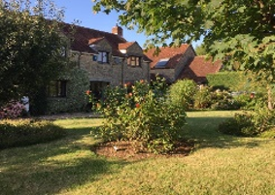
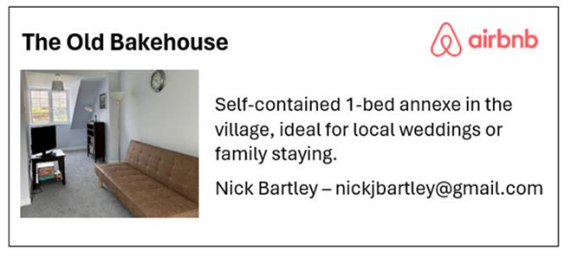
Martin Bennett – Local Mechanic
(based in Hinton St Mary)
I repair and service modern and everyday cars as well as specialising in repairing and restoring classic cars.
I have diagnostics equipment available.
Phone 07746817072
Email martin@mbclassiccars.co.uk
NIGEL BASTABLE LTD
CARPENTRY & JOINERY
The Building Yard – Hinton St Mary
Doors, Windows, Wardrobes, Stairs, Kitchens, Cupboards, Bookcases Etc.
Renovations and Repairs
01258 860459
nigelbastable@btinternet.com www.nigelbastable.co.uk
BABYSITTER & DOG SITTER/WALKER
I am Alice Townsend
I live in Hinton St Mary and I am offering babysitting or dog sitting/ walking in our village.
You can contact me via my phone 01258 474603
Ot my email ar.townsend@outlook.com
Rose’s Yard
Hinton St Mary
Air B and B
Self-Contained first floor annex
in the centre of the village
sleeping 4
Contact Jo
jo.martin99@btinternet.com
07860 612412
Or Book Via Air B & B

