Slide 1

The Mosaic
Hinton St Mary
October 2026
Hinton St Mary Parish Council
The Parish Council would like to thank all people who attended the Extraordinary meeting of the Parish Council in the Village Hall on 14th October. A record 23 attendees!
The Ward Boundary Consultation closes on 9th November we would encourage ALL residents to submit their views. We thank all residents and those linked to organisations who have taken the time and trouble to make comments.
Comments can be submitted:
1. WEBSITE www.lgbce.org.uk/all-reviews/dorset
2. Email reviews@lgbce.org.uk
3. In writing:
Review Officer
LGBCE
7th Floor
3 Bunhill Row
London
EC1Y 8YZ
Should any resident benefit from help and support in submitting their views please feel free to contact Celia Wright (celia.wright@icloud.com ; Mobile 07584 151600)
20 mph Consultation
The Parish Council would like to thank everyone who has submitted their views and would encourage residents to submit their view by the deadline 6th November 2026.
www.dorsetcouncil.gov.uk/tros
Once on website click on the box Comment on static Traffic Regulation Orders.
Click Start Now (Green Box)
You will find Hinton St Mary (P4T2) As an active consultation (click on pop up blue box - Respond to Consultation) to make comments.
Excessive Speeding B3092
Following comments from several residents the Parish Council have this subject as an agenda item at our next Parish Council meeting in the Village Hall on Tuesday 10th November 7pm. All are welcome to attend.

Slide 2

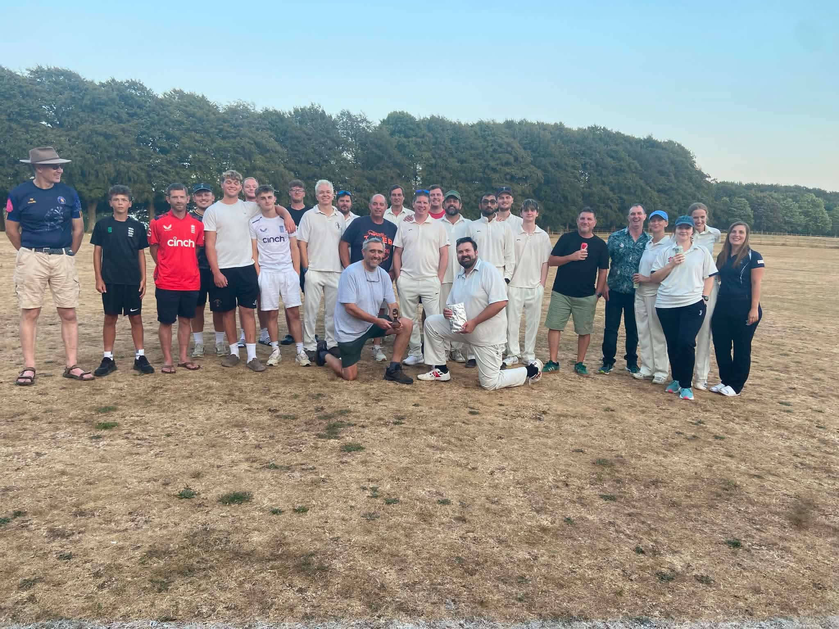
Another season concluded for Hinton & Ibberton cc with a fantastic night at The White Horse.
Once again we were treated to great food, and excellent hospitality from every one at the Horse, we would like to thank them and every who joined in on the night, including those who thought they were going to have quiet romantic meals!
The Ashes were retained! and once again are home above the fire place at the pub.
Congratulations to all our winners, and every one who was involved during the season.
It made it an incredibly successful and enjoyable one.
With fixtures already booked in, and new teams wanting to play us, 2027 looks promising already.

Slide 3
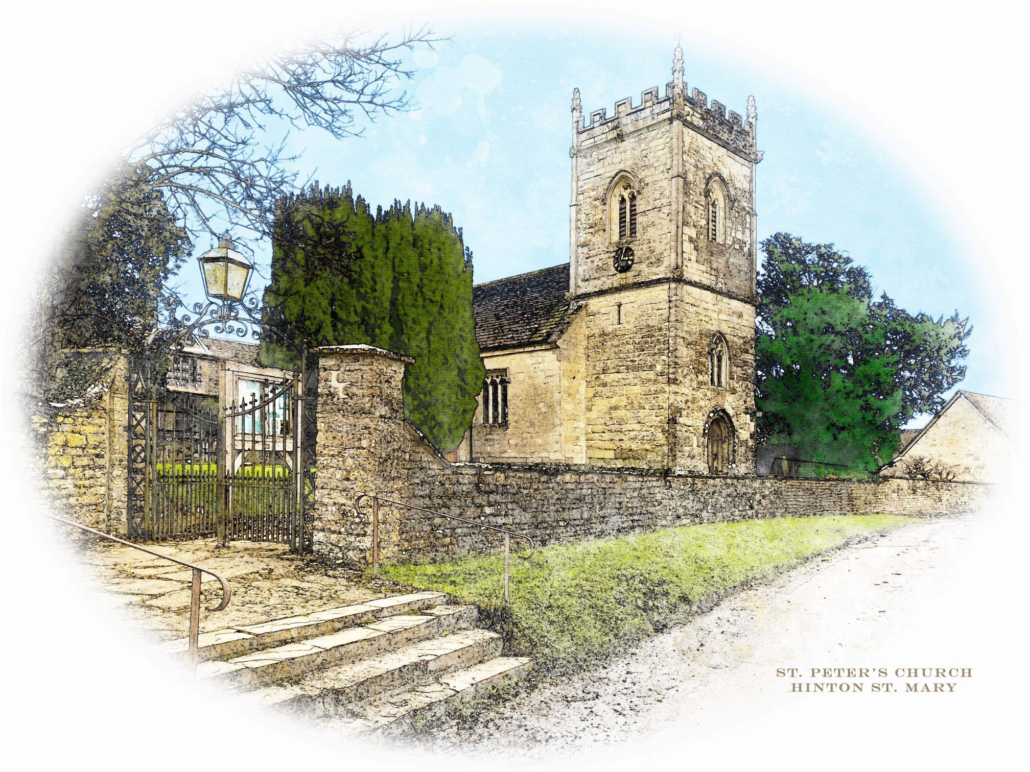

St Peter’s Church
November 2026 Services
All services at 9:30am unless otherwise noted
Date | Service
Sunday 01 Nov | Holy Communion & Commemoration of the Departed (BCP)
Sunday 08 Nov 10:50am | Remembrance Service
Sunday 15 Nov | Morning Prayer
Sunday 22 Nov | Holy Communion (CW)
Sunday 29 Nov 11:00am | Benefice Holy Communion
The Church is open daily for sanctuary and prayer.
November Events
If you would like to have someone mentioned during the Commemoration of the Departed at the Holy Communion service on 1 November, please either put their name on the list in the Church or tell the Vicar.
The village Act of Remembrance is on Sunday, 8 Nov starting at 10:50.
The service on Sunday, 29 Nov is a Benefice Holy Communion starting at 11:00 for Advent Sunday.
Vicar: The Reverend Mary Gubbins 01258 721 704 | 07440 680 387 | The Vicarage, Sturminster Newton revd.mary.gubbins@gmail.com
Churchwardens
Robin Gibbs 01258 471 493 robin@aviaconsult.uk | Kevin Peto-Bostick 01258 475 469 kevin.peto.bostick@gmail.com

Slide 4


Slide 5

.

Slide 6

Hello Hinton
Thank you very much for coming to our Halloween party. Despite the weather we had great fun. A big thank you to Steve for the music and Lucy for the decorations.
Prizes this year go to;
Rosie Richmond Woods - best pumpkin, Guinness themed – perfect for the pub!
Best Dressed – The Procter Family for their 101 dalmatians.
This Sunday we have Mark & Jane’s November Quiz starting at 7pm. £2 per person entry teams up to 6.
On Sunday 8th of November Belle st Duo are returning with their usual upbeat vibe of modern pop sung in a vintage style starting at 6:30pm.
On the 6th of December we will have our Christmas quiz for charity. This year we are supporting Ducks and Drakes. This is a local charity which supports young people with cancer. We will be supporting them throughout Christmas & New Year with our sales of Mosaic lager as well so please do come along.
Please see below our Christmas opening Hours. Please note that we are open on Monday 21st and Tuesday 22nd of December as well as Monday 28th and Tuesday 29th of December.
We are all looking forward to these events and we thank you for your continued support.
Best Wishes
Andy, Mel & The White Horse team

Slide 7
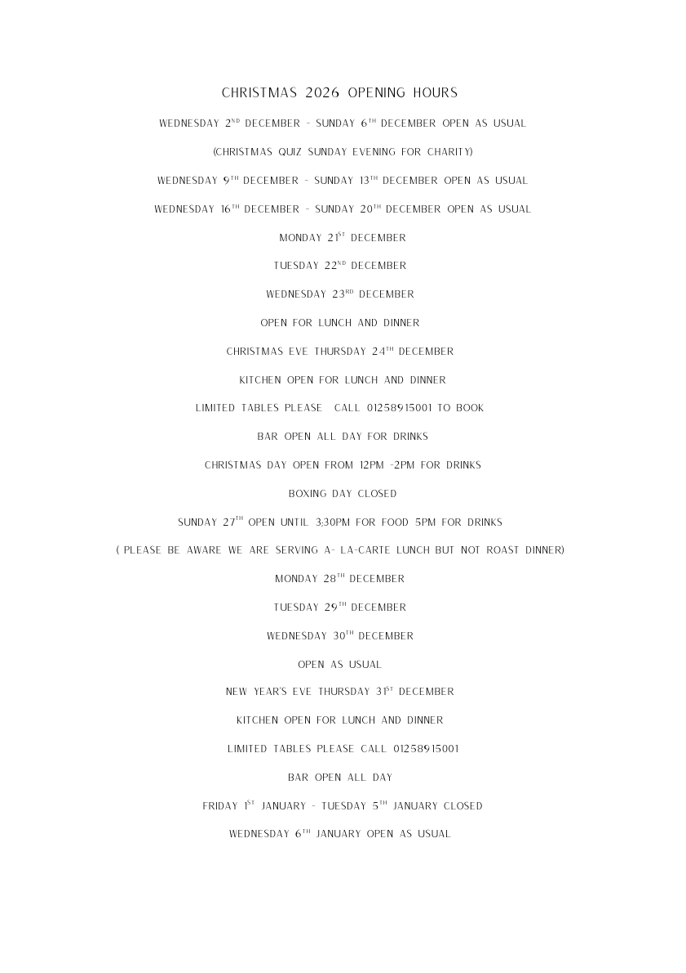

Slide 8

Easy Beef Stew Recipe
Ingredients
750g stewing beef, cubed
2 tbsp flour
2 tbsp oil
1 onion, chopped
3 carrots and 2 potatoes, chopped
2 garlic cloves, minced
500ml beef stock
1 tbsp tomato purée
1 tsp thyme
Salt and pepper
Method
Coat beef with flour, salt and pepper.
Brown it in hot oil, then set aside.
Soften the onion and garlic.
Add everything to the pot and stir.
Cover and simmer gently for 2–2½ hours, until tender.

Slide 9

THE MONTHLY VILLAGE COFFEE MORNING
TUESDAY 3rd NOVEMBER
10.30 – 12.00
The cost is £1.50– for as much coffee or tea as you can drink
and as many biscuits as you can eat.
BLANDFORD HOSPITAL SHOP WAREHOUSE. Is open to receive donations at its warehouse in The Building Yard HSM on Saturday 7th November 10 - 12 midday Old Poisedale Building, Hinton St. Mary
IF YOU LIVE IN HINTON ST MARY AND DO NOT RECEIVE A COPY OF THE MOSAIC EVERY MONTH – PLEASE LET JANE KNOW ON 07513 632550 OR EMAIL janefilbey1964@gmail.com
Please let me have any articles, notices, celebrations, information, items for sale, trusted traders etc you would like to have included in next month’s Mosaic. Deadline 24th of the Month. Thank you, Jane. Janefilby1964@gmail.com
VILLAGE HALL to enquire about or book please contact Jane Filbey on 07513 632550 or janefilbey1964@gmail.com
Keep abreast of all things ‘HSM’ on the village facebook page: Hinton St Mary Village Group and the Hinton St Mary Website:
http://www.hintonstmary.com where all previous copies of The Mosaic are also available.
Thank you to our Advertisers and our sponsors:
Mr & Mrs Pitt Rivers, Hinton St Mary Parish Council, St Peter’s Church, HSM Village Hall Committee.
CONTACT THE ESTATE:
If you are out and about on the estate and need to contact us for any reason whatsoever, please call
07747 773787 or email us on info@hintonstmaryestate.com and we will do our best to respond as quickly and possible.

Slide 10

Trusted Traders
These are tradesman/workers who have been personally recommended by villagers. Please let us have details of anybody who has done a great job for you. Thank you.
COMPUTER HELP | TIM WEST | 01258 817537 sturcomputers@hotmail.co.uk
CURTAINS, BLINDS, TRACKS, FABRICS & FITTING (Marnull) | THE CURTAIN MAN (Anna & Tony) | 01258 821117 thecurtainmanshop@gmail.com
CARPENTRY/JOINERY | NIGEL BASTABLE | 01258 860459 www.nigelbastable.co.uk
CARPENTRY (& WOODEN FLOORS) | GARY CORCORAN | 07920557651 gccarpentry@hotmail.co.uk
APPLIANCE REPAIRS | ANDY BLANDFORD | 07484 861797 andyblandford1@gmail.com
PEST CONTROL | MARK GOULD (Rats, Wasps, Moles & Fleas) | 07999 957694 mark_gould2@btconnect.com
BUILDERS | ANDREW TRIM | 07939 541128
FENCING & REPAIRS | DAVID WHITEHAND | 07549 151 799
BOILER MAINTENANCE | BOB JONES & SON | 01963 362 502
PRIVATE CARER | TINA BROWN | 0777 5430457
BUILDING & RENOVATION | MARK GORDGE | 07941 443 306
ROOFING | BEN GIBBS ROOFING | 07912 655095 Bengibbs.roof@gmail.com
SCAFFOLDING | EDW SCAFFOLDING | 07474 552259 elwin1965@icloud.com
HEDGE/TREE CUTTING | HAMBLEDONS 0783347833 | 01258 721552 info@hambeldons.co
PLASTERER | ROBBY PROCTOR | 07872 634677 robbyproctor29@gmail.com
CHIMNEY SWEEP | CHRIS PERRINS 07824 698109 | 01258 837499 cfperrins@gmail.com
PLUMBER | GARY WATKINS | 07887 605112 sales@tradetanks.com

Slide 11




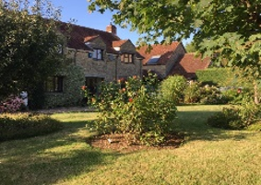
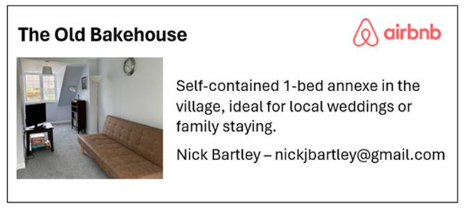
Martin Bennett – Local Mechanic
(based in Hinton St Mary)
I repair and service modern and everyday cars as well as specialising in repairing and restoring classic cars.
I have diagnostics equipment available.
Phone 07746817072
Email martin@mbclassiccars.co.uk
NIGEL BASTABLE LTD
CARPENTRY & JOINERY
The Building Yard – Hinton St Mary
Doors, Windows, Wardrobes, Stairs, Kitchens, Cupboards, Bookcases Etc.
Renovations and Repairs
01258 860459
nigelbastable@btinternet.com www.nigelbastable.co.uk
BABYSITTER & DOG SITTER/WALKER
I am Alice Townsend
I live in Hinton St Mary and I am offering babysitting or dog sitting/ walking in our village.
You can contact me via my phone 01258 474603
Ot my email ar.townsend@outlook.com
Rose’s Yard
Hinton St Mary
Air B and B
Self-Contained first floor annex
in the centre of the village
sleeping 4
Contact Jo
jo.martin99@btinternet.com
07860 612412
Or Book Via Air B & B

